Slide 1
Present Value with Compound Interest
Liberal Arts Mathematics

Slide 2
Overview
Present Value Formula for Compound Interest
Examples

Slide 3
Reminder
Present value is the amount of money in an account now.
Future value is the amount of money in the account at some time in the future.
The point of calculating present value is to know how much you need today to reach a future goal.
If you need $20,000 to buy a new car five years from now, how much do you need to invest today?

Slide 4
Present Value Formula for Compound Interest
Present Value with Compound Interest

Slide 5
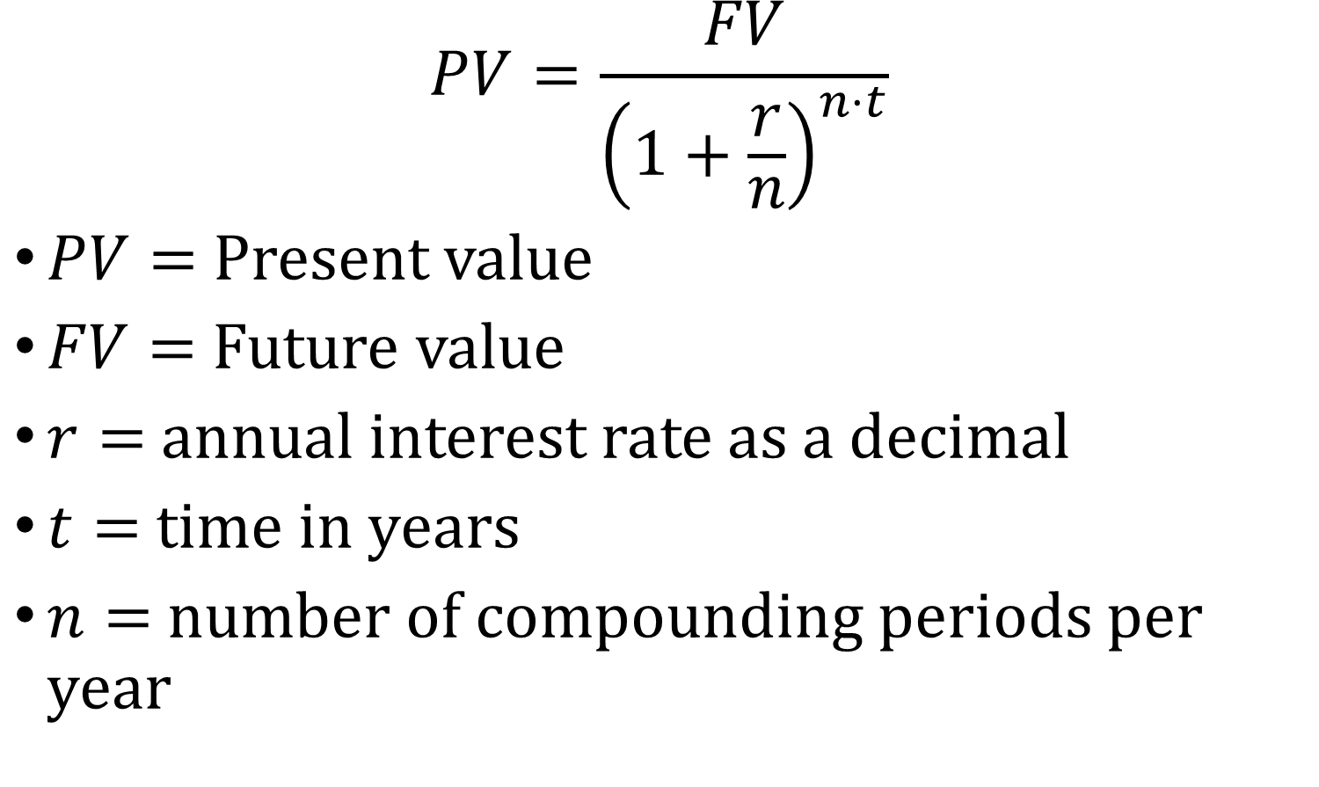
Formula
$$PV=\frac{FV}{{\left(1+\frac{r}{n}\right)}^{n⋅t}}$$
$PV=$ Present value
$FV=$ Future value
$r=$ annual interest rate as a decimal
$t=$ time in years
$n=$ number of compounding periods per year

Slide 6
Examples
Present Value with Compound Interest

Slide 7
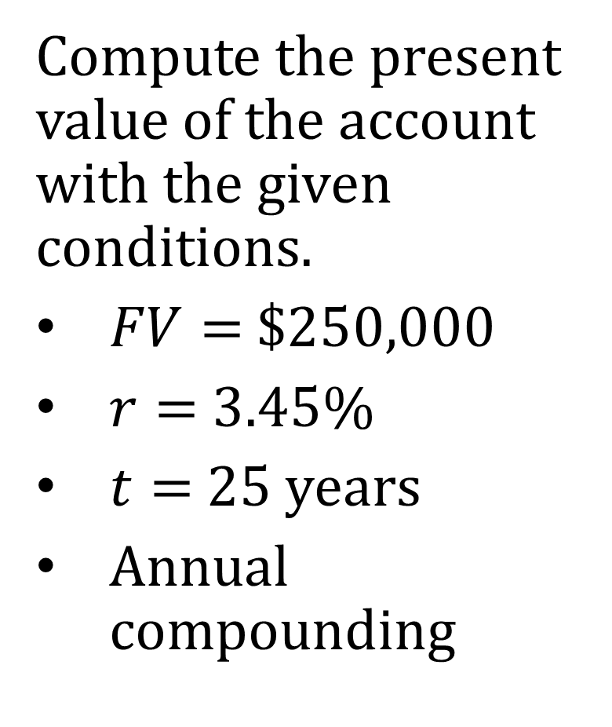
Example 1
Compute the present value of the account with the given conditions.
$FV=$ $250,000
$r=$3.45%
$t=$ 25 years
Annual compounding

Slide 8
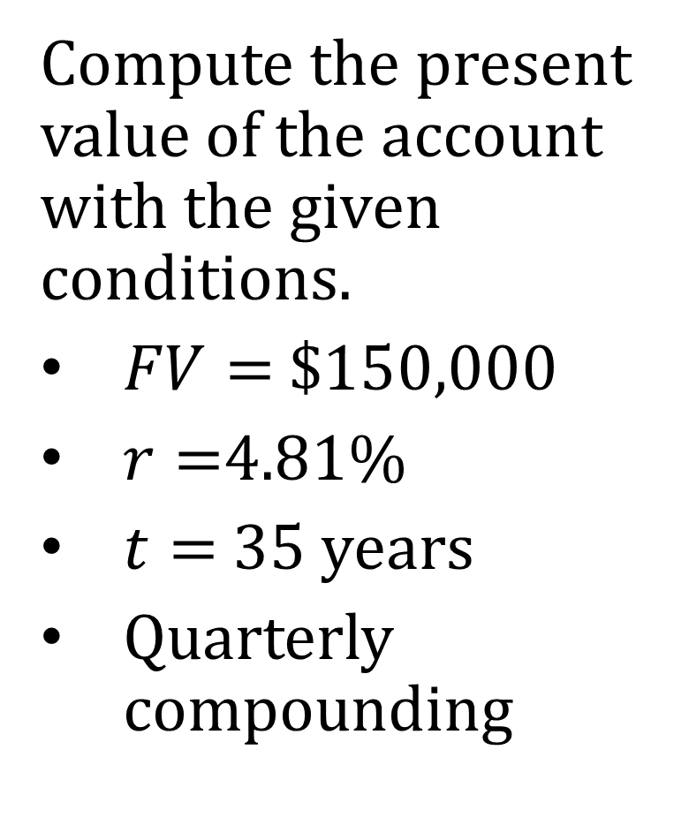
Example 2
Compute the present value of the account with the given conditions.
$FV=$ $150,000
$r=$4.81%
$t=$ 35 years
Quarterly compounding

Slide 9
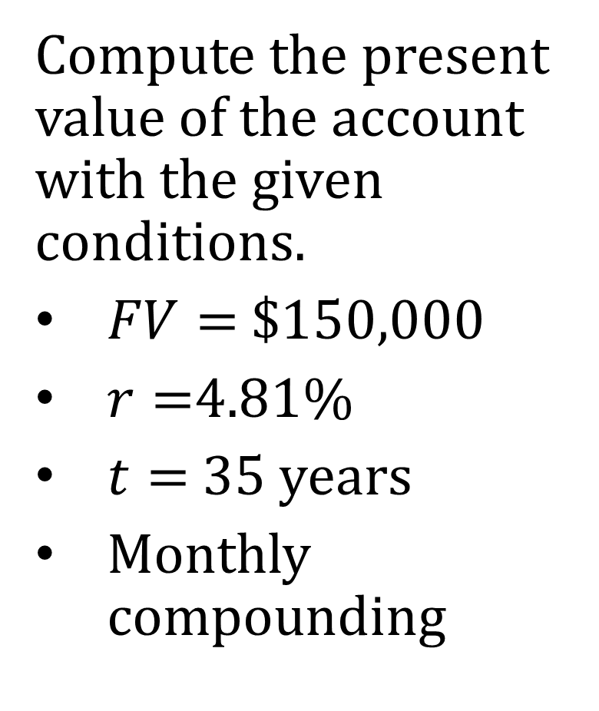
Example 3
Compute the present value of the account with the given conditions.
$FV=$ $150,000
$r=$4.81%
$t=$ 35 years
Monthly compounding

